Slide 1
TechXChange – Microsoft Track

Slide 2
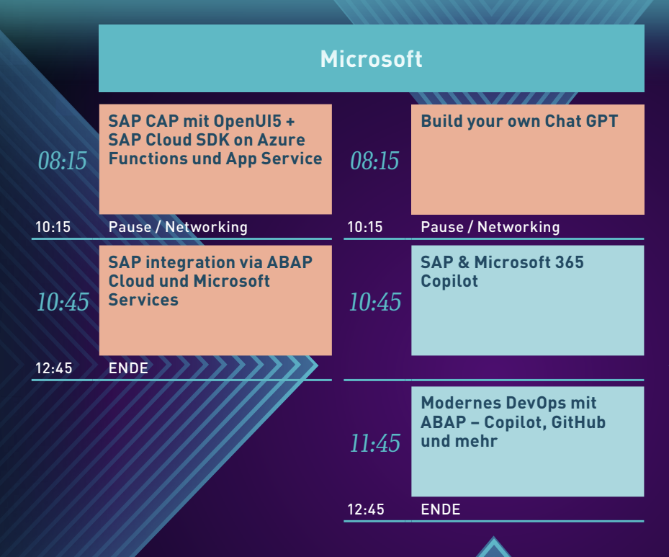
https://github.com/martinpankraz/dsagtechxchange24

Slide 3
SAP CAP on Azure

Slide 4















Azure Cosmos DB for PostgreSQL
(powered by citus extension)
Azure
Microsoft Entra ID
(formerly Azure AD)
Resource Group
Codespaces
App Service
powered by
App Service Plan
(F1: Linux, free)
SAP CAP
azd up
Key Vault
Log Analytics
OData
App Insights
Shared Dashboard
for „upped“ app
Entra ID App Registration

Slide 5


Azure Cosmos DB for PostgreSQL
(powered by citus extension)
Azure
Microsoft Entra ID
(formerly Azure AD)
Resource Group
Codespaces
App Service
powered by
App Service Plan
(F1: Linux, free)
SAP CAP
azd up
API
Management
Key Vault
git push
azd up
Log Analytics
OData
GitHub Action
App Insights
Shared Dashboard
for „upped“ app
Entra ID App Registration
authorized

Slide 6
ABAP Cloud with Microsoft

Slide 7
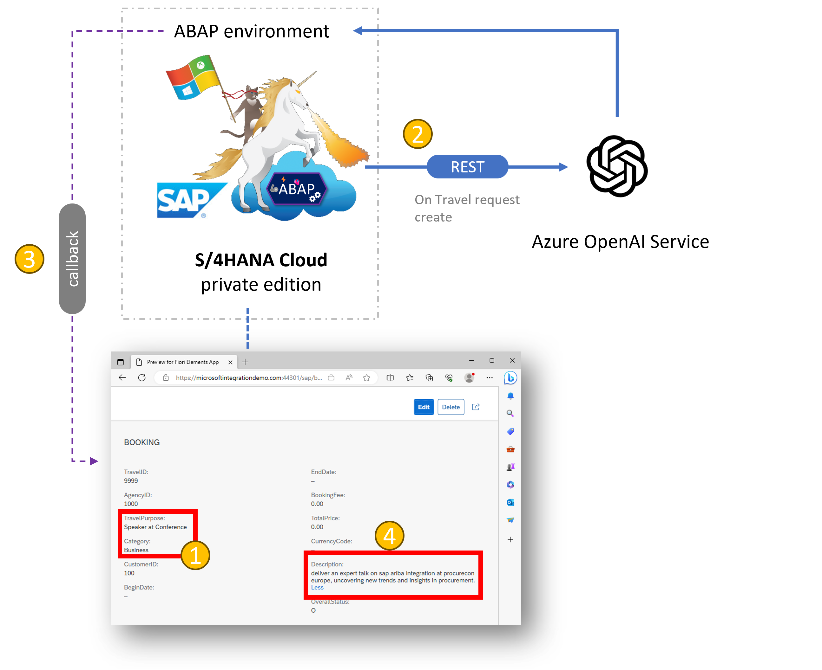
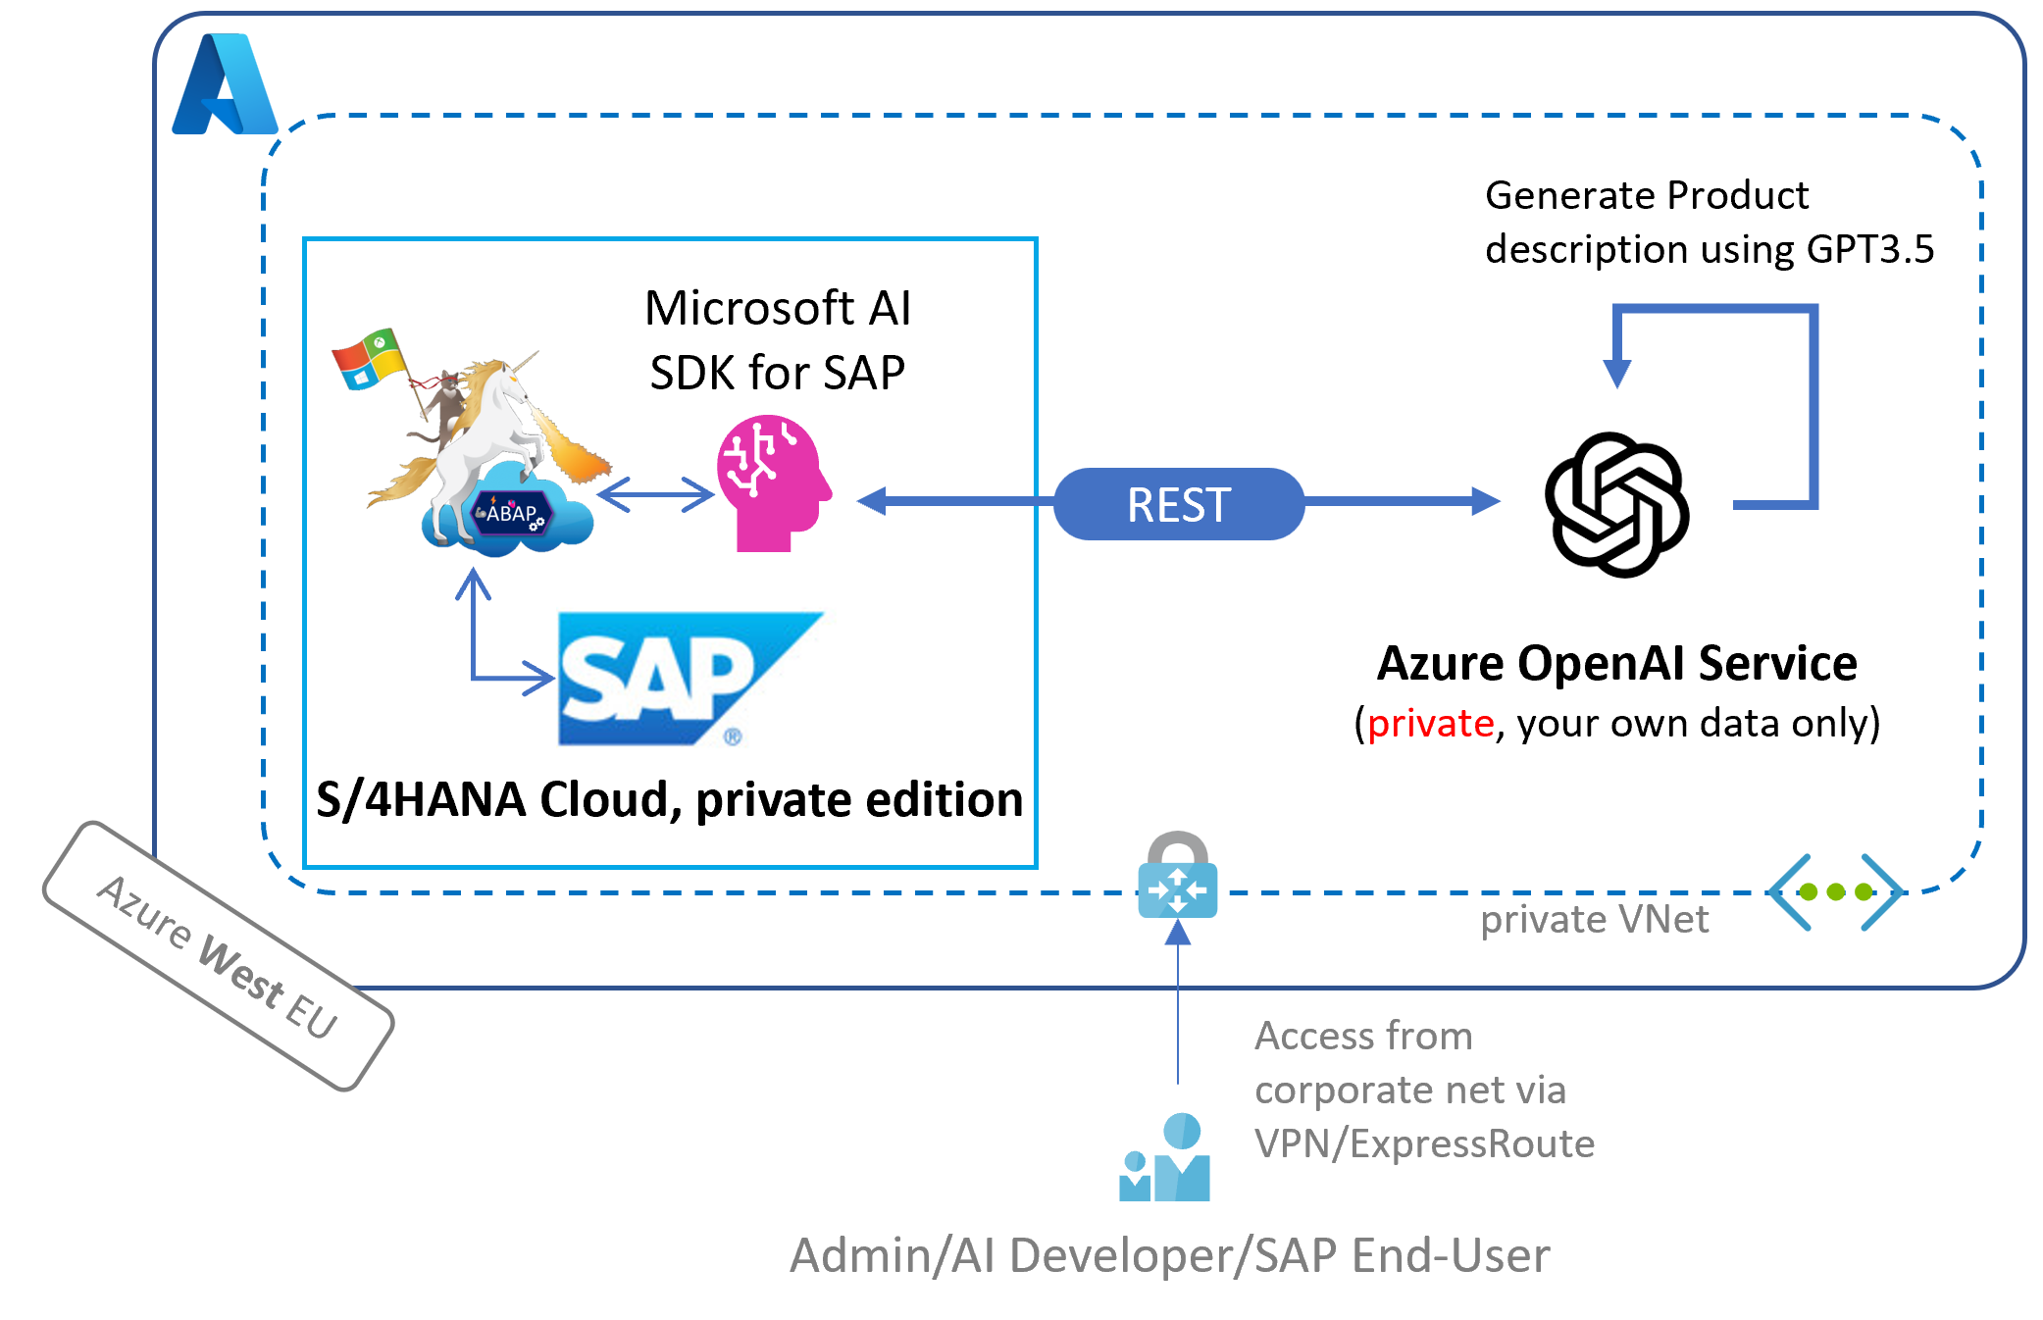
Mittels dem AI SDK und Embedded Steampunk schneller zur SAP AI Implementierung

Slide 8
Build your own ChatGPT

Slide 9
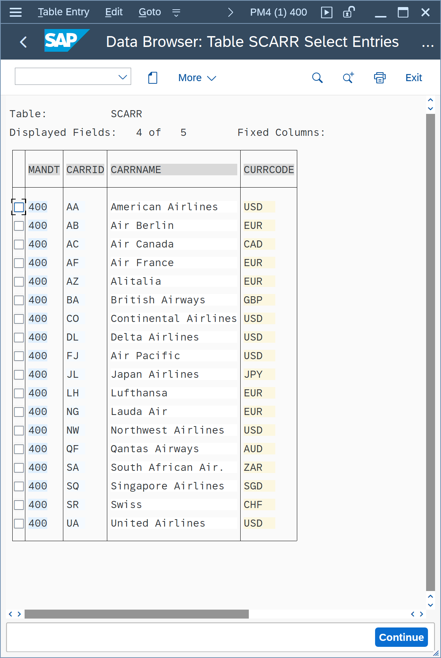
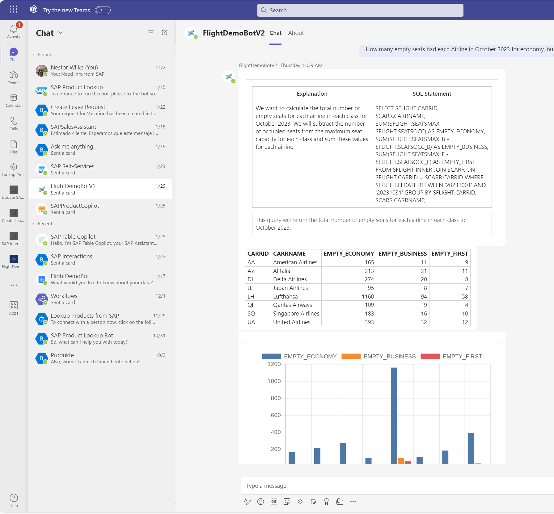
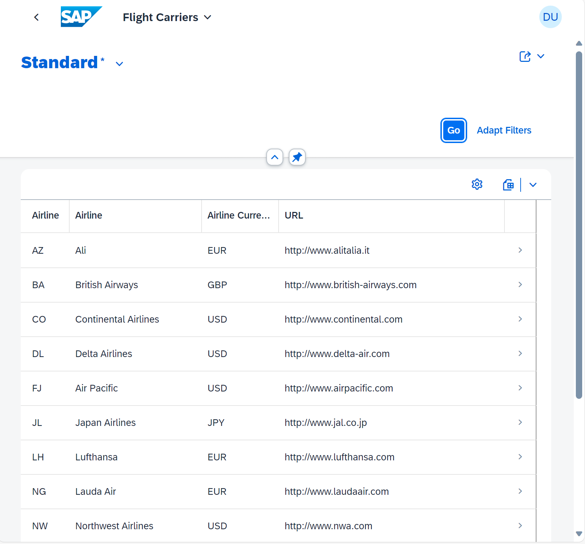
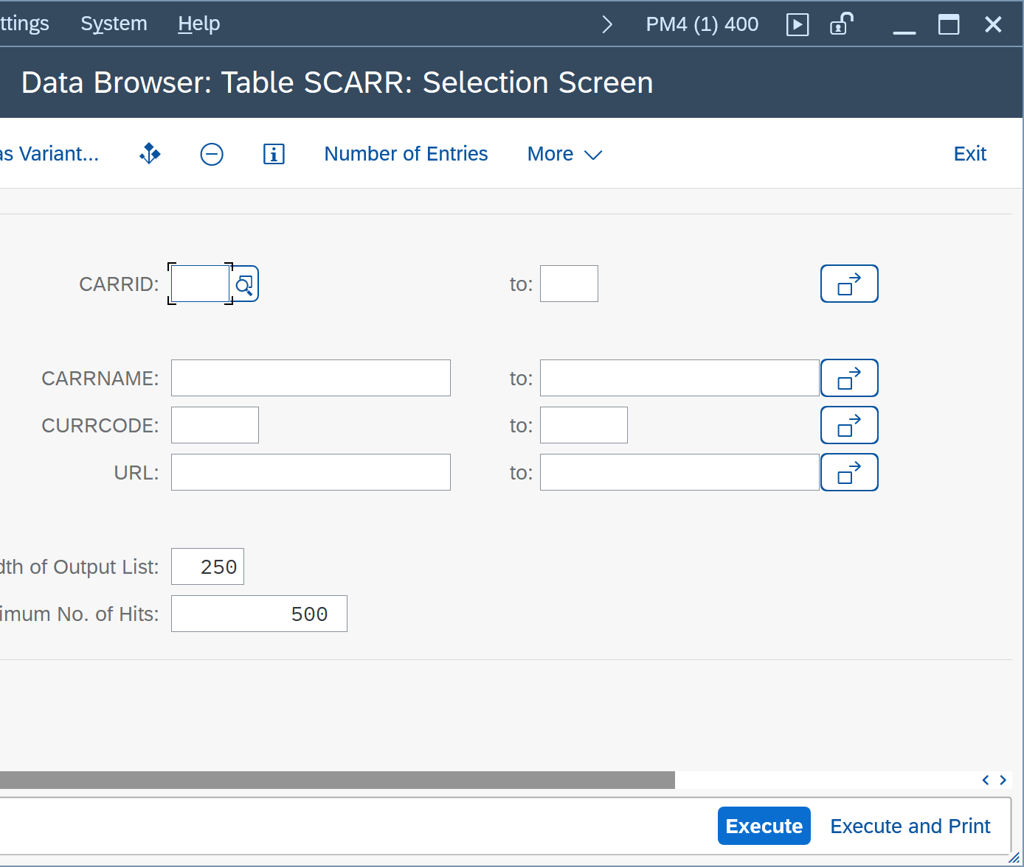
ChatBots?!?
TERMINAL
UI
Chat with AI
Expert Systems
You need to know what and how
Everyone can use it
The app defines / limits what you can do
Everyone can use it
Explore what‘s possible

Slide 10
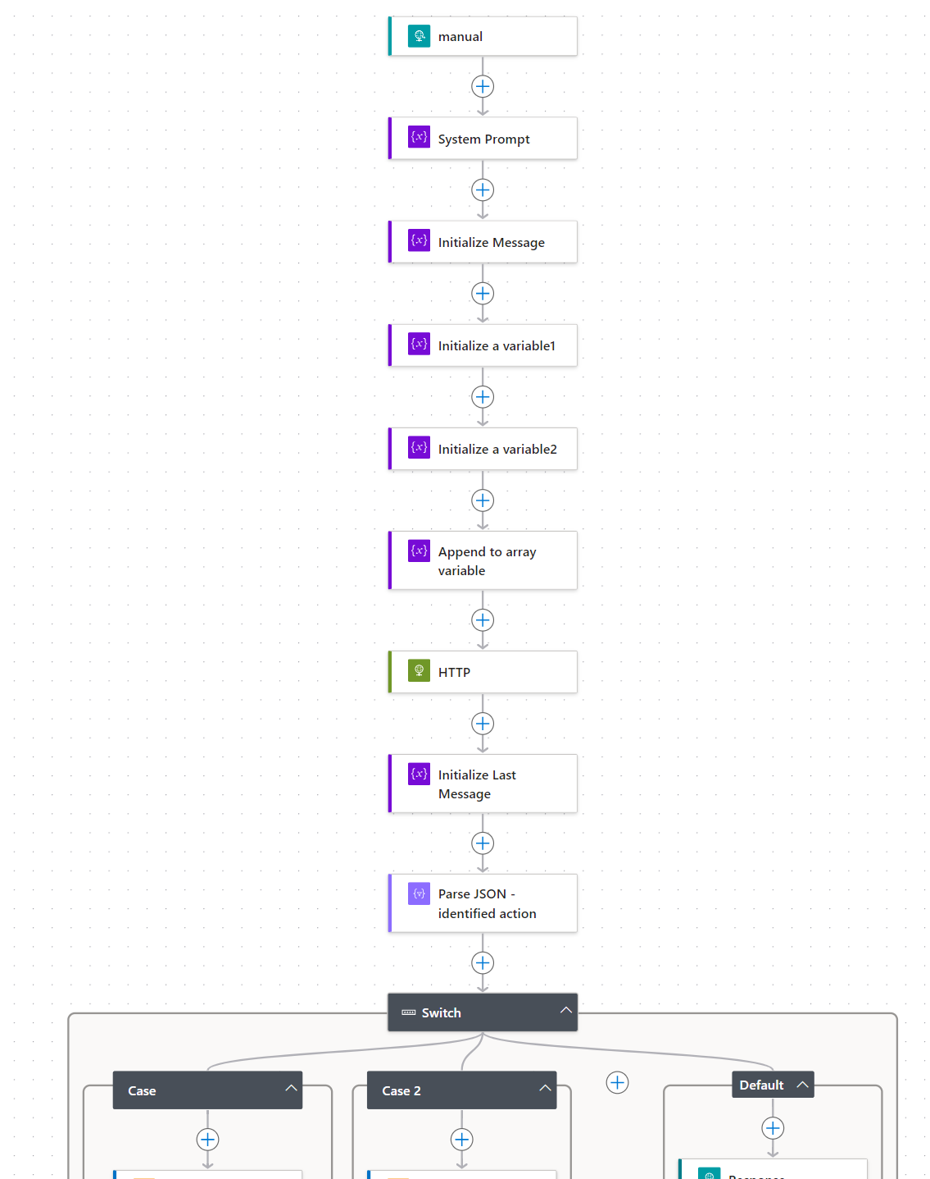


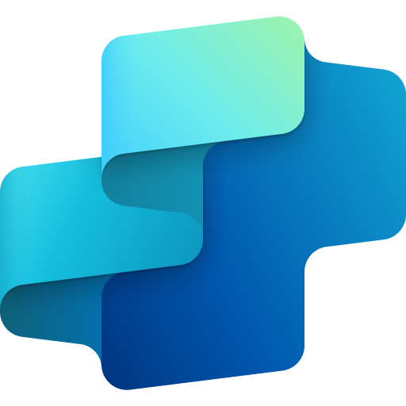


Public Website / SharePoint
Power Automate
Generative AI
Copilot Studio
Azure Open AI
Documents

Slide 11
Credentials für heute gibt’s hier
👇
https://aka.ms/dsag-tt-24-microsoft

Slide 12
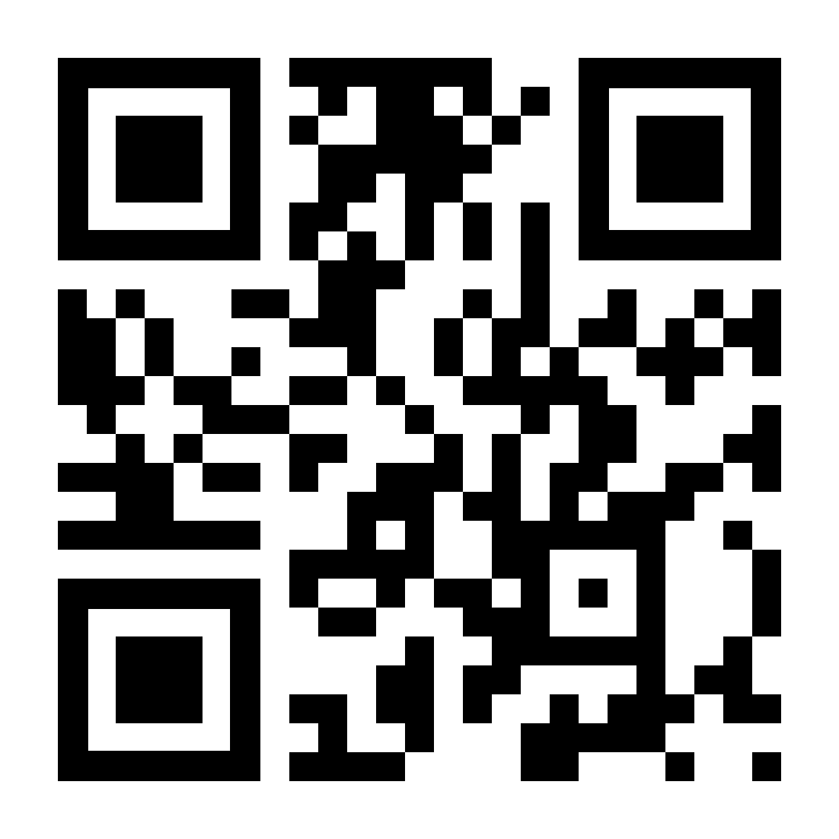

Roadmap-Wünsche, Feedback und Projekt-Ideen gerne im Gespräch direkt an uns. Link bleibt 30 Tage offen.
📬martin.pankraz@microsoft.com
📬holger.bruchelt@microsoft.com
https://www.linkedin.com/in/martin-pankraz/
https://www.linkedin.com/in/holger-bruchelt/
https://aka.ms/meet-martin

